Slide 1
Snowflake Computing Project Overview
By – lakshmipathiraju Pericharla

Slide 2
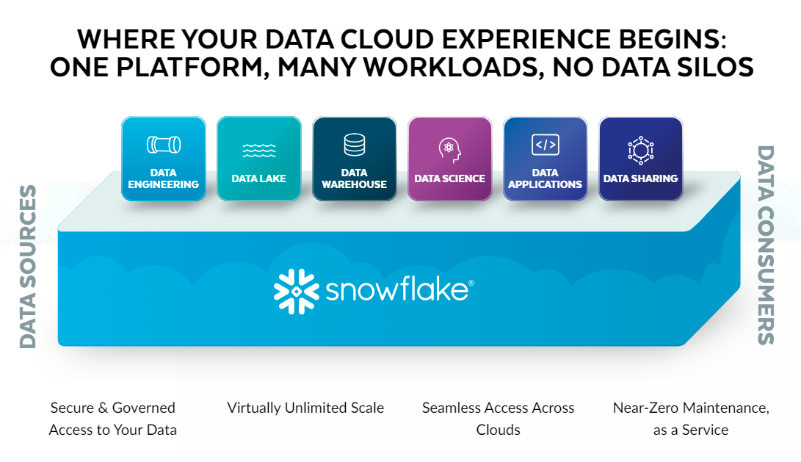

Slide 3
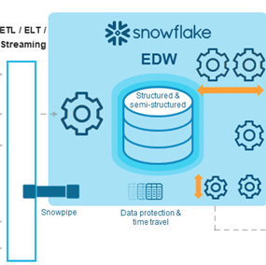



Local computer Using Snow CLI
Cloud Provider
AWS/Azure/GCP
Data Visualization via AWS Quick Sight
Using Snowflake Web Interface
Concepts that will be covered in this project
Snowflake Architecture
Data Ingestion
Data Transformation
Data Pipeline
Performance Optimization
Time Travel
Streaming Data from AWS S3 using SQS

